Slide 1
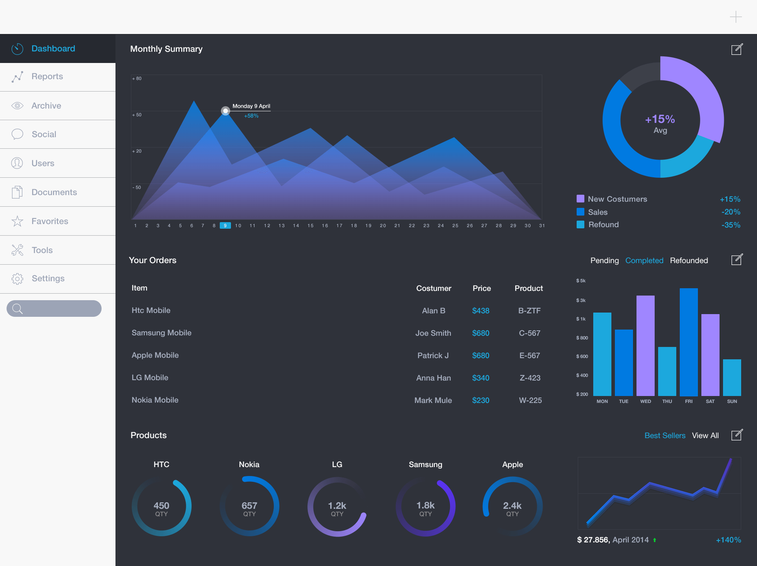

Slide 2

Maturity by SOE
Top 5 Organizations by Maturity
Bottom 5 domain of organization
Name | Sector | Targeted Score | Observed Score | Top Domain
ASYAD | Shipping | 3.5 | 2.9 | SPE5
OETC | Energy | 4.0 | 3.0 | SPE1
NWC | Water | 3.2 | 2.3 | SPE1
Oman Air | Transport | 4.5 | 3.9 | SPE2
Oman Airport | Transport | 4.5 | 3.9 | SPE2
Select the organization
Top 5 Organizations by Maturity
Select the organization

Slide 3
Maturity by SOE
Select the organization
Select the organization
Top 5 Organizations by Maturity
Name | Sector | Targeted Score | Observed Score | Top Domain
ASYAD | Shipping | 3.5 | 2.9 | SPE5
OETC | Energy | 4.0 | 3.0 | SPE1
NWC | Water | 3.2 | 2.3 | SPE1
Oman Air | Transport | 4.5 | 3.9 | SPE2
Oman Airport | Transport | 4.5 | 3.9 | SPE2
Bottom 5 domain of organization
Top 5 Organizations by Maturity

